Slide 1
NUMBERS AND STRINGS

Slide 2
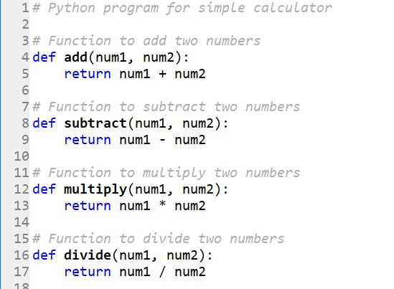
NUMBERS IN PYTHON

Slide 3
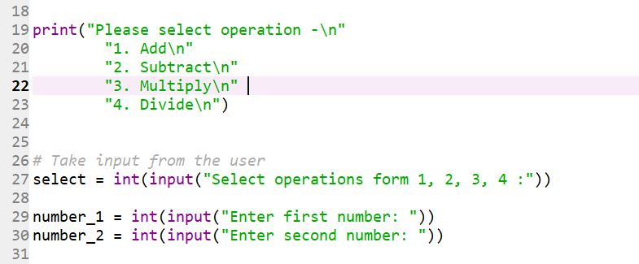

Slide 4
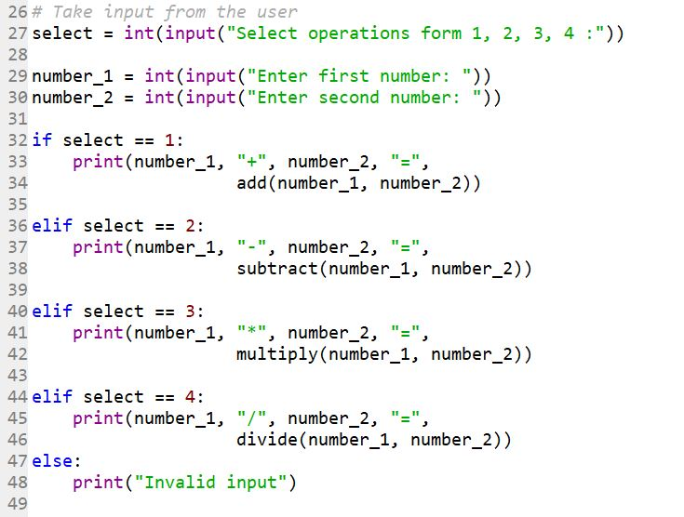
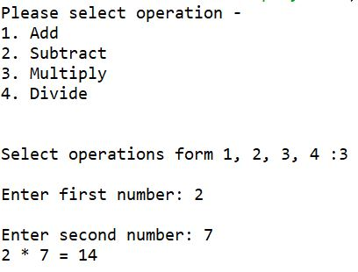

Slide 5
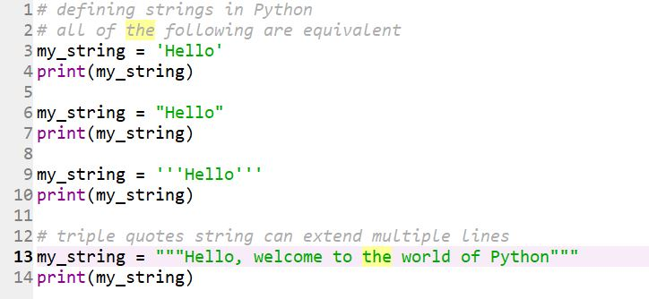
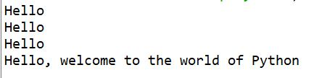
STRINGS

Slide 6
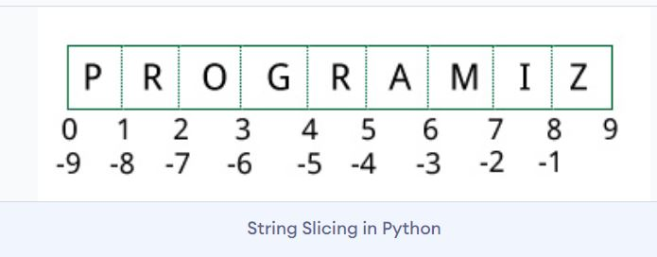
SLICING OF STRINGS
It is the method of accessing the characters of a string.
All characters of a string, INCLUDING SPACE CHARACTER, are assigned an arbitrary number from 0 to N (N is the number assigned to the last letter of the string) when reading from LEFT TO RIGHT.
They are assigned numbers from -1 To –N (N is the number assigned to First letter of the string) when reading from RIGHT TO LEFT.

Slide 7
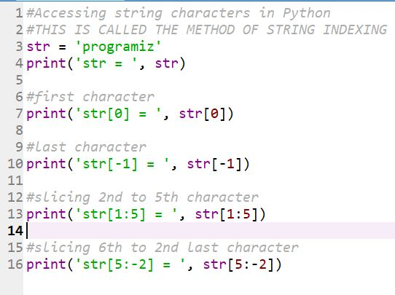
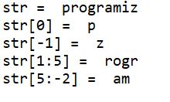
STRING INDEXING

Slide 8
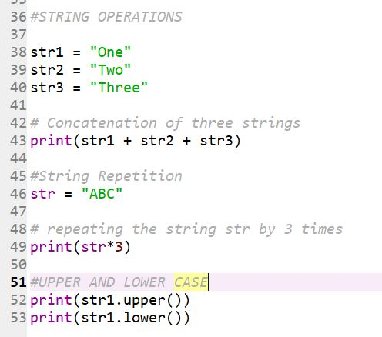
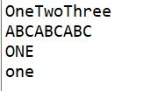
STRING OPERATIONS

